Slide 1
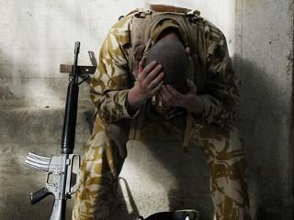
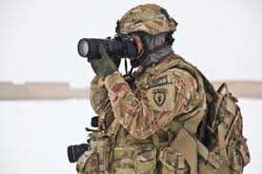
Starter: Remind yourself of Remains and War Photographer

Slide 2

Assessment Objectives
AO1: Read, understand and respond to texts. Students should be able to: maintain a critical style and develop an informed person response; use textual references, including quotations, to support and illustrate interpretations.
AO2: Analyse the language, form and structure used by a writer to create meanings and effects, using relevant subject terminology where appropriate.
AO3: Show understanding of the relationships between texts and the contexts in which they were written.
AO4: Use a range of vocabulary and sentence structures for clarity, purpose and effect, with accurate spelling and punctuation.
Notes:
Resource 1. Additional help for this task can be found on p. 6 & 7 in the poetry student book.

Slide 3
Date: 2008
Conflict
Title: Remains
Poet: Simon Armitage
Main Idea/ Theme:
The experiences of war have long-lasting consequences
Language:
Colloquialisms
Caesura
Consonance
Conversation markers
Verbs linked to violence
Free Verse
Enjambment
Imagery:
The memory of the dead man becomes more vivid as the poem progresses
Context:
The story of a soldier with PTSD who talks about an incident when he was serving in Basra, Iraq. This is based on interviews.
Tone: Conversational (which seems at odds with the subject matter)
Rhythm/ Rhyme:

Slide 4
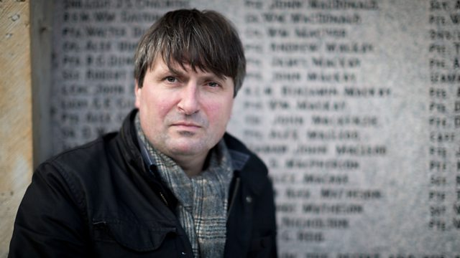
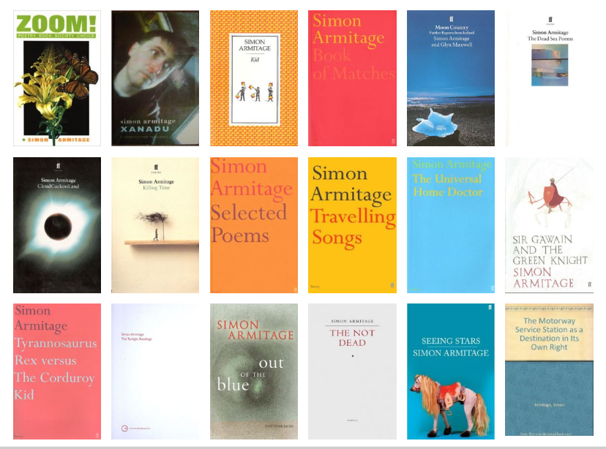
Simon Armitage
Also makes documentaries on travel, history and literature
Enjoys exploring class stories from ancient cultures like the Odyssey
Seen as being a poet for everyday people (like Wordsworth aimed to be)
These are poems of survivors - the damaged, exhausted men who return from war in body but never, wholly, in mind. In terse, undecorated language, Armitage conveys their sense of nullification, focusing on war's endlessness, the past barrelling insistently into the present at every turn. At one remove from the wars he's writing about, Armitage positions himself as a witness not to the dead but to the living: a poet for today's unsung victims.
Review of Not Dead from the Guardian

Slide 5
Date: 1985
Conflict
Title: The War Photographer
Poet: Carol Ann Duffy
Main Idea/ Theme:
The horrors which are witnessed in war have an impact on those who survive
Language:
Metaphor
Enjambment
Caesura
Biblical reference
Contrast
Sibilance
Imagery:
Lots of imagery linked to religion and people as ghosts.
Context:
This poem is based on conversations with two war photographers who found it difficult to record the horrors of war and then watch them being treated as abstract images.
Tone:
Contemplative/ reflective
Rhythm/ Rhyme:
Regula rhyme scheme (ABBCDD). One break.

Slide 6
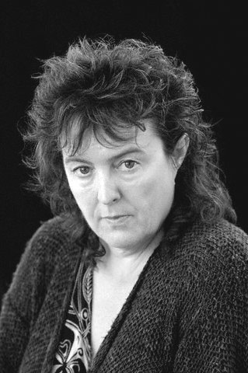
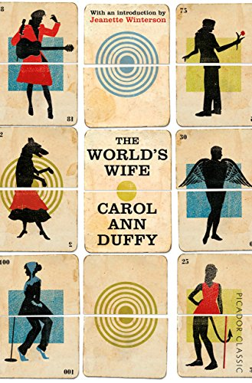
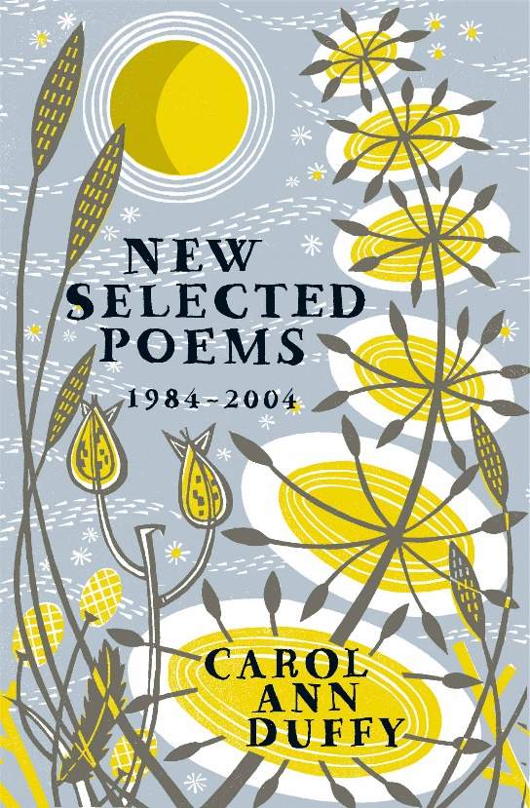
Carol Ann Duffy
Current poet laureate
Has written poems from the point of view of the wives of famous men in history.
Tends to write from the point of view of those who don’t have a voice (e.g. she wrote a poem about the world cup final from the point of view of a football)

Slide 7
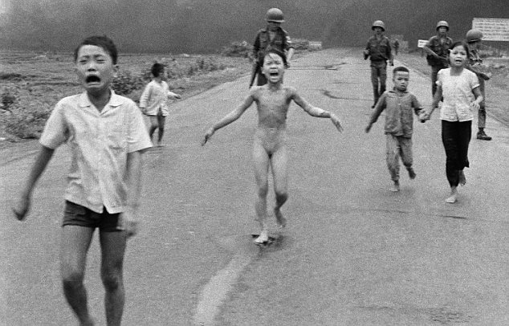

Slide 8
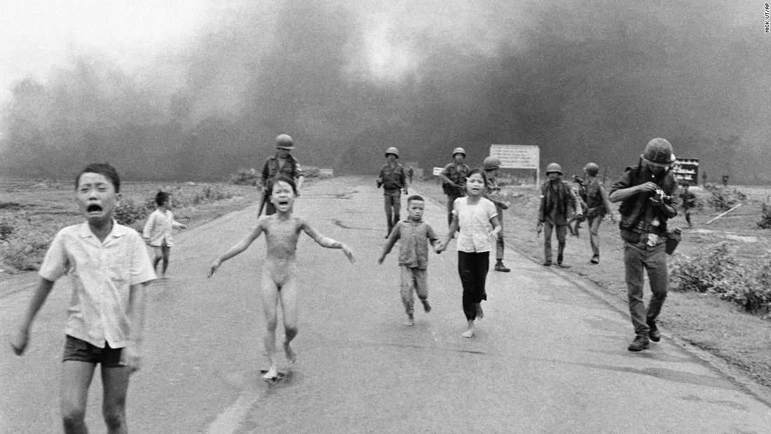

Slide 9
Comparing the poems
Feature/ technique | Remains Simon Armitage | War Photographer Carol Ann Duffy
War and conflict have mental, as well as physical consequences | The memories of war ‘remain’ long after the events and haunt the soldier who killed the man. | The photographer finds returning to normal life unsettling as it creates a sense of guilt in him when he contrasts it with what he has seen in conflict zones.
Stream of consciousness/ narrative forms | Moves from action to reflection and guilt | Moves from action to reflection to presenting different consumers of the photographer’s work
Role of the witness | Duty of the poet to help people to understand the continued suffering of soldiers | Sacred duty to honestly and sensitively record the truth, no matter how hard

